Slide 1

Bundesliga hackathon EinHacked Frankfurt Dynamic pricing model analysis
Mikhail Tiuterev
James Bailey
Robin Cameron
Yannick Westermann

Slide 2




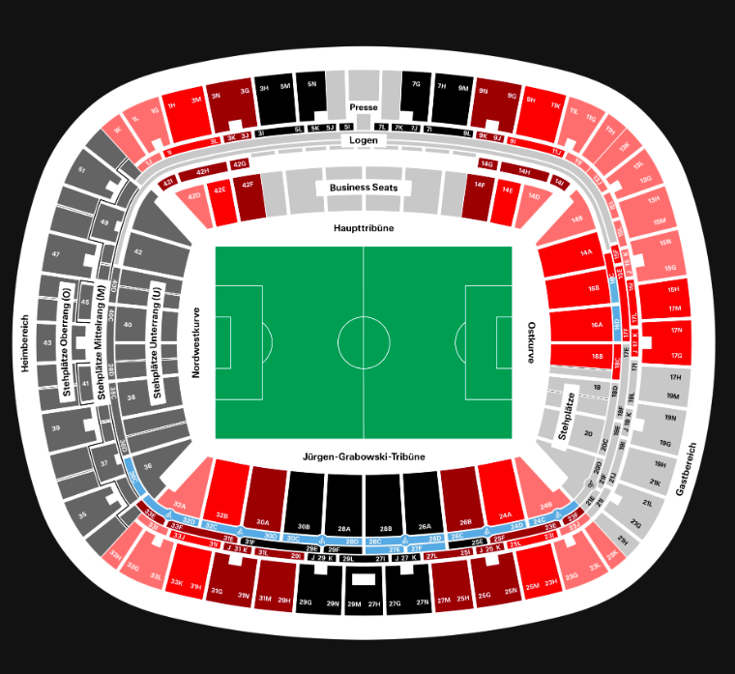







Pricing Factors
Opponent
Seat category
Day of the Week
Starting time

Slide 3
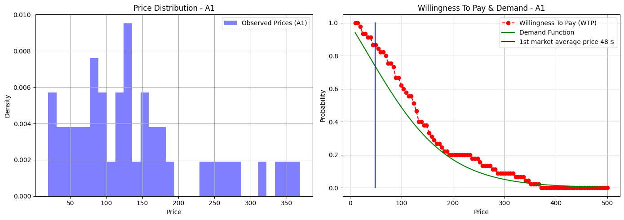
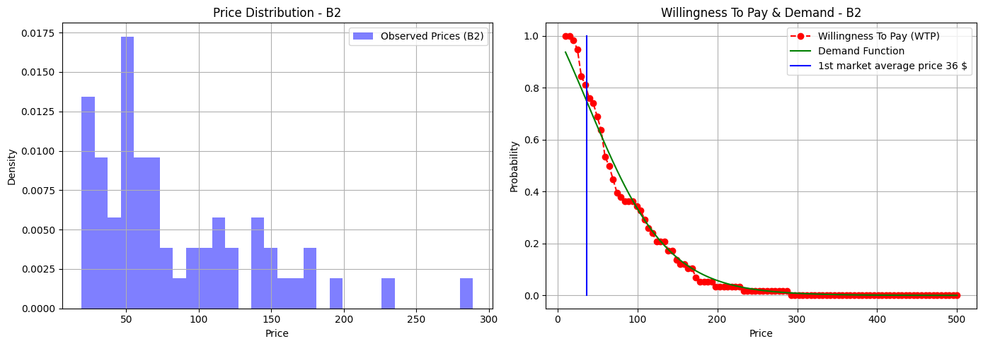
Willingness to pay. Auction prices
Naming
A, B – opponent quality
1-4 – sitzplatz type
Auctions reflect true market demand
Ebay auction data was taken
Each category was analyzed separately
Not much data was found. Possibility to improve

Slide 4
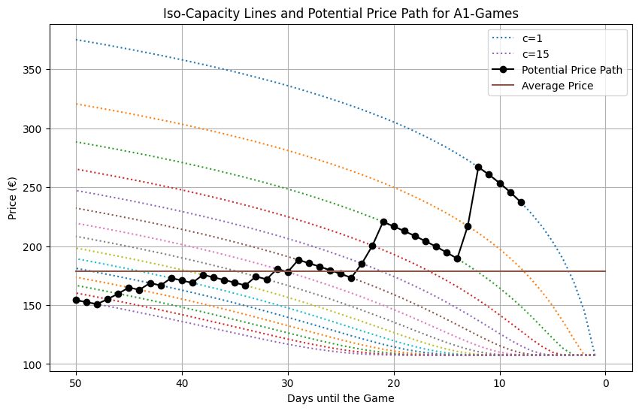
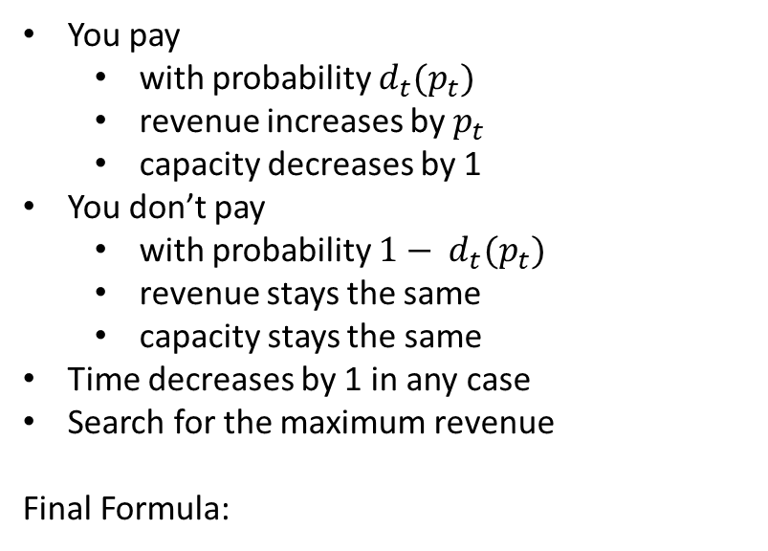
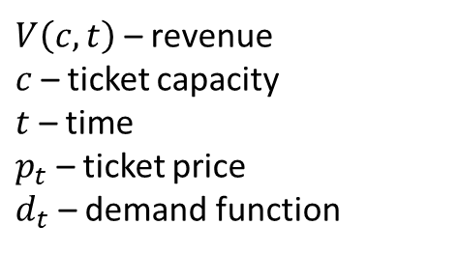
Bellman’s equation. Monte-Carlo simulation
$V\left(c,t\right)$ – revenue
$c$ – ticket capacity
$t$ – time
$p_{t}$ – ticket price
$d_{t}$ – demand function
You pay
with probability $d_{t}(p_{t})$
revenue increases by $p_{t}$
capacity decreases by 1
You don’t pay
with probability ${1− d}_{t}(p_{t})$
revenue stays the same
capacity stays the same
Time decreases by 1 in any case
Search for the maximum revenue
Final Formula:
$$V\left(c,t\right)=\max_{p_{t}}\left[ d_{t}(p_{t})⋅\left( p_{t}+ V\left(c−1, t−1\right)\right)+ \left(1 − d_{t}(p_{t})\right)⋅V\left(c, t−1\right)\right]$$

Slide 5
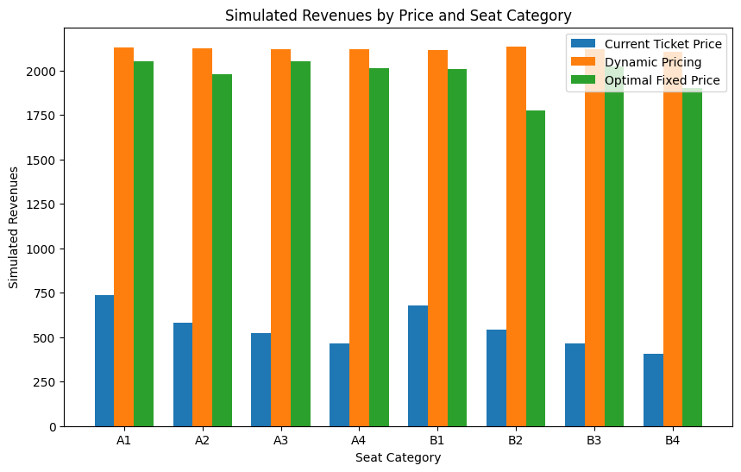
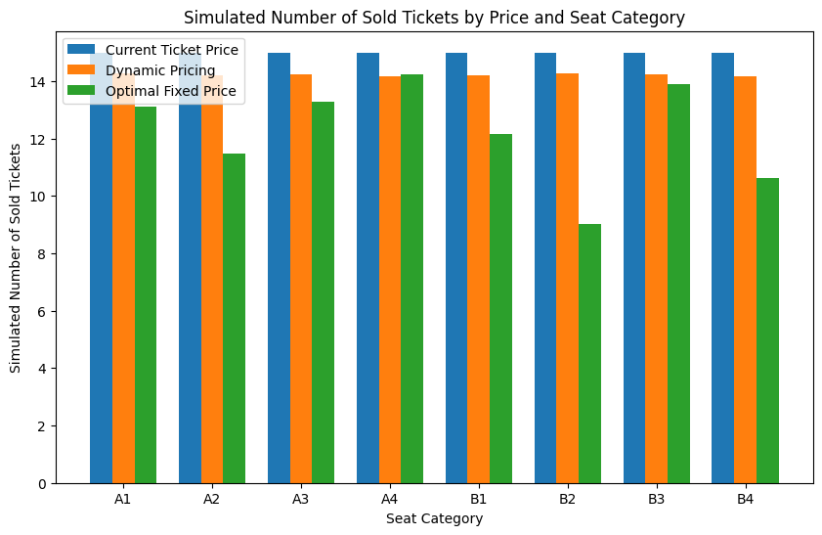
Results. Revenue & Attendance
Dynamic pricing maximizes the revenue from all the categories
A LOT OF MONEY
Even more, most of the seats will be filled. So, more food, beverages, park spaces will be sold
EVEN MORE MONEY

Slide 6
Thanks for watching See you in Frankfurt
Text & Presentation: Mikhail Tiuterev
Voice: AI Gen

